Slide 1
Object Oriented Programming—C++ Lecture9 Class Keywords & Polymorphism
Qijun Zhao
College of Computer Science
Sichuan University
Spring 2023

Slide 2
Class Keywords
this
static
const
mutable
using
friend
delete

Slide 3
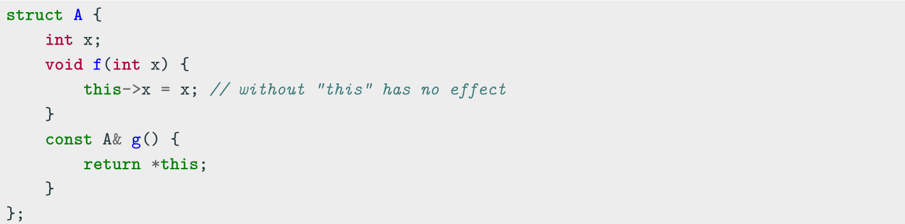
Class Keywords——this
this
Every object has access to its own address through the const pointer this
Explicit usage is not mandatory (and not suggested)
this is necessary when:
• The name of a local variable is equal to some member name
• Return reference to the calling object

Slide 4
Class Keywords——static
static
The keyword static declares members (fields or methods) that are not bound to class instances. A static member is shared by all objects of the class
• A static member function can only access static class members
• A non- static member function can access static class members
• Non-const static data members cannot be directly initialized inline (see
Translation Units lecture)...before C++17

Slide 5
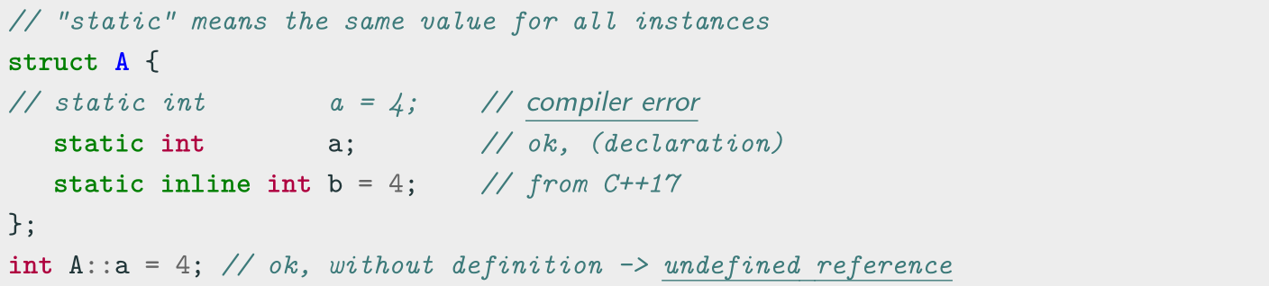
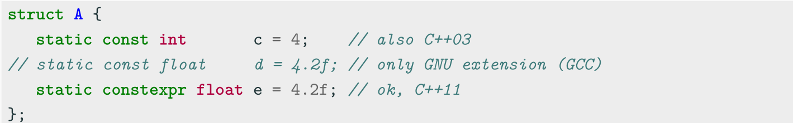
Class Keywords——static-Initialization
Mutable static members
Constant static members

Slide 6
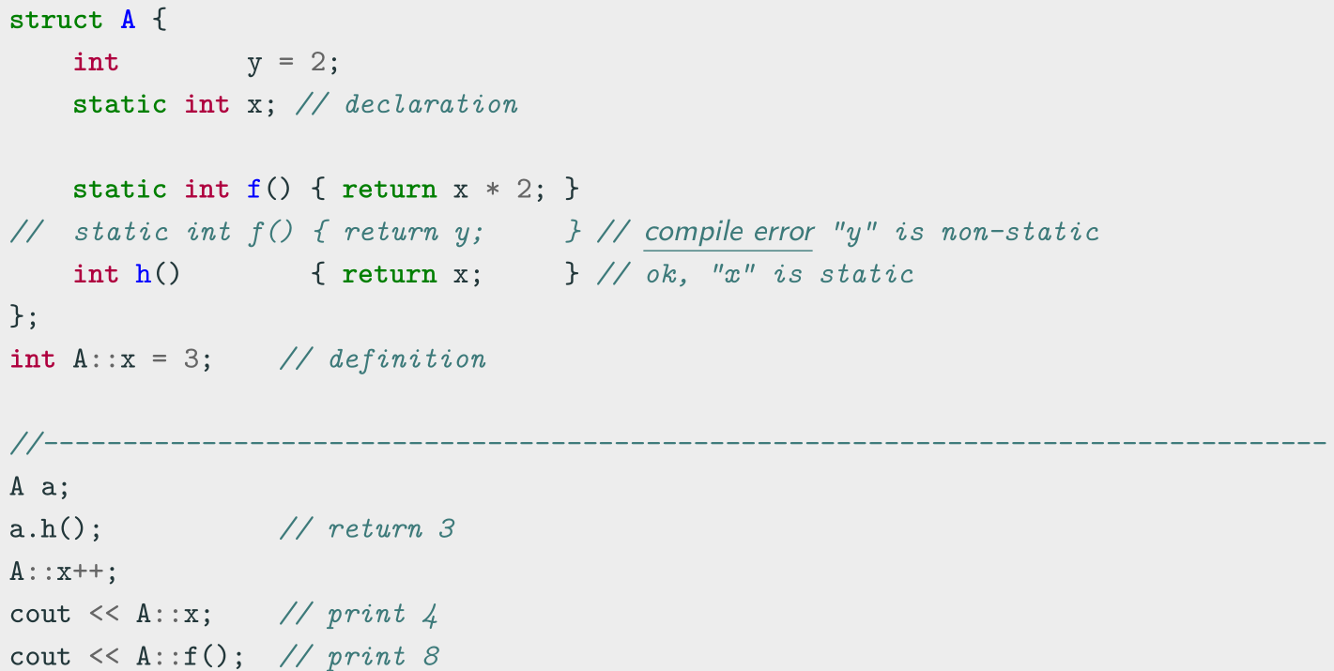
Class Keywords——static-Example

Slide 7
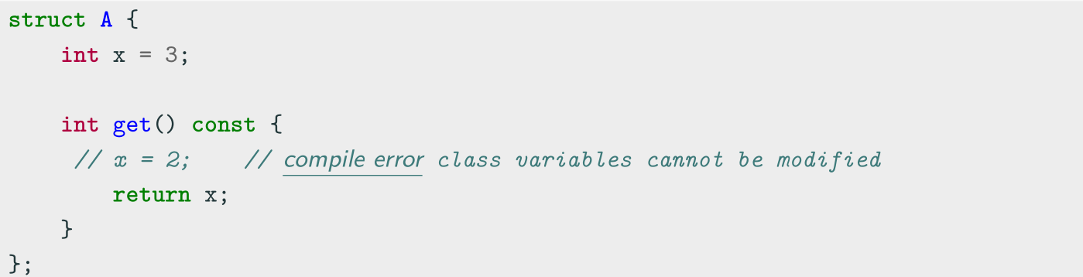
Class Keywords——const
Const member functions
Const member functions (inspectors or observer) are functions marked with const that are not allowed to change the object state
Member functions without a const suffix are called non-const member functions or mutators. The compiler prevents from inadvertently mutating/changing the data members of observer functions

Slide 8
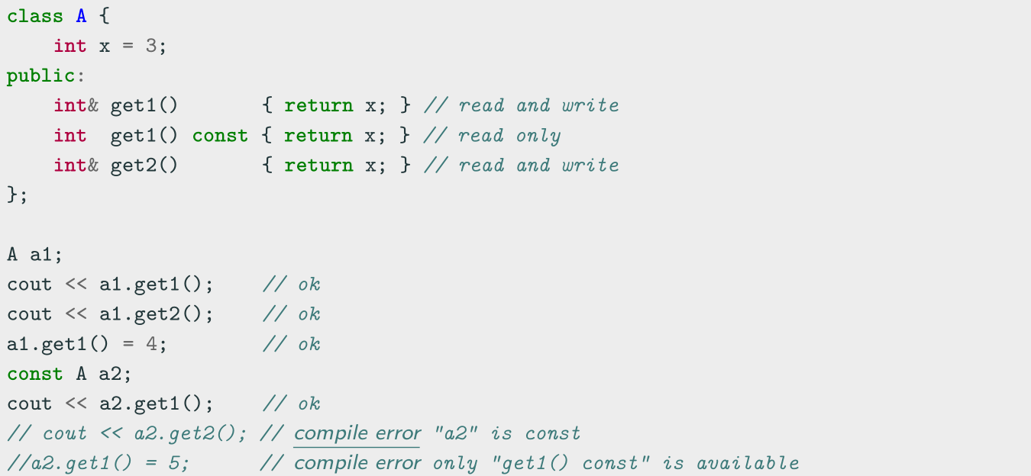
Class Keywords——const Overloading
The const keyword is part of the functions signature. Therefore a class can
implement two similar methods, one which is called when the object is const , and
one that is not

Slide 9
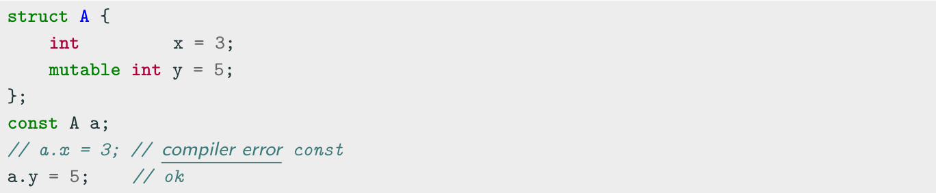
Class Keywords——mutable
mutable
mutable members of const class instances are modifiable
Constant references or pointers to objects cannot modify objects in any way, except for
data members marked mutable
• It is particularly useful if most of the members should be constant but a few need to be
modified
• Conceptually, mutable members should not change anything that can be retrieved from
the class interface

Slide 10
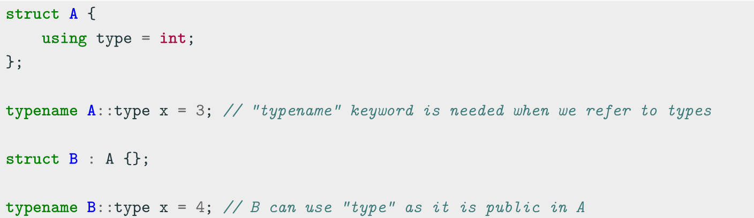
Class Keywords——using for type declaration
The using keyword is used to declare a type alias tied to a specific class

Slide 11
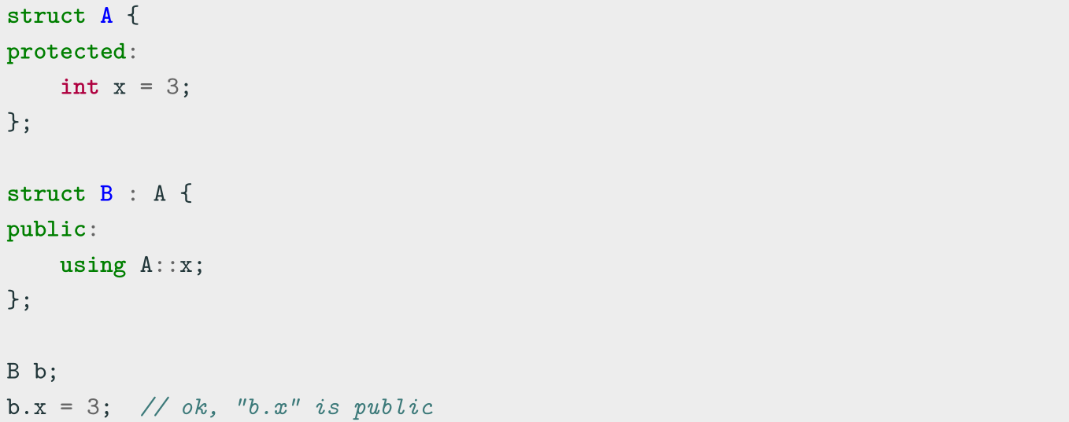
Class Keywords——using for Inheritance
The using keyword can be also used to change the inheritance attribute of member
data or functions

Slide 12
Class Keywords——friend
friend Class
A friend class can access the private and protected members of the class in which it is declared as a friend
Friendship properties:
• Not Symmetric: if class A is a friend of class B, class B is not automatically a
friend of class A
• Not Transitive: if class A is a friend of class B, and class B is a friend of class C,
class A is not automatically a friend of class C
• Not Inherited: if class Base is a friend of class X, subclass Derived is not
automatically a friend of class X; and if class X is a friend of class Base, class X is
not automatically a friend of subclass Derived

Slide 13
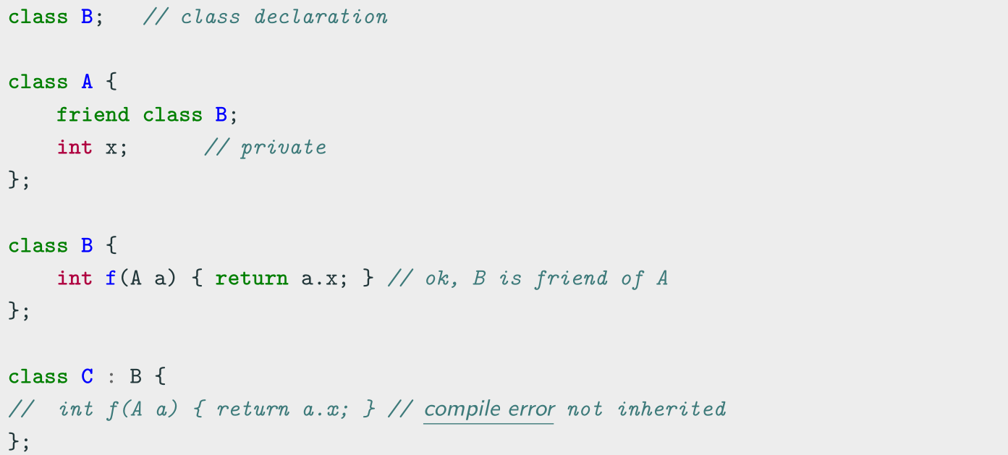
Class Keywords——friend

Slide 14
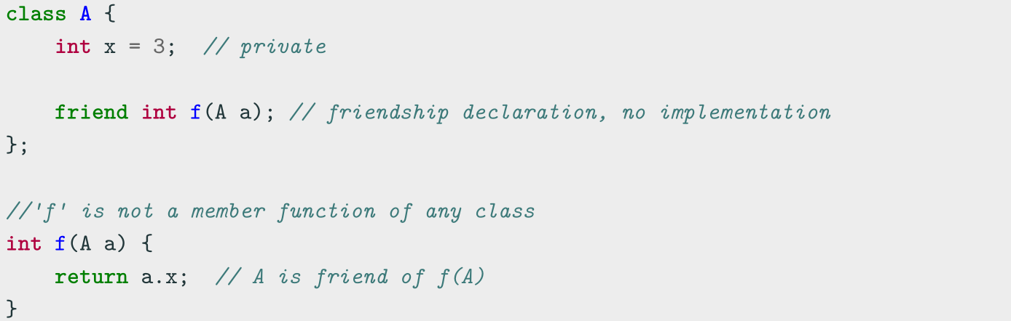
Class Keywords——friend
friend Method
A non-member function can access the private and protected members of a class if it is declared a friend of that class
friend methods are commonly used for implementing the stream operator operator<<

Slide 15
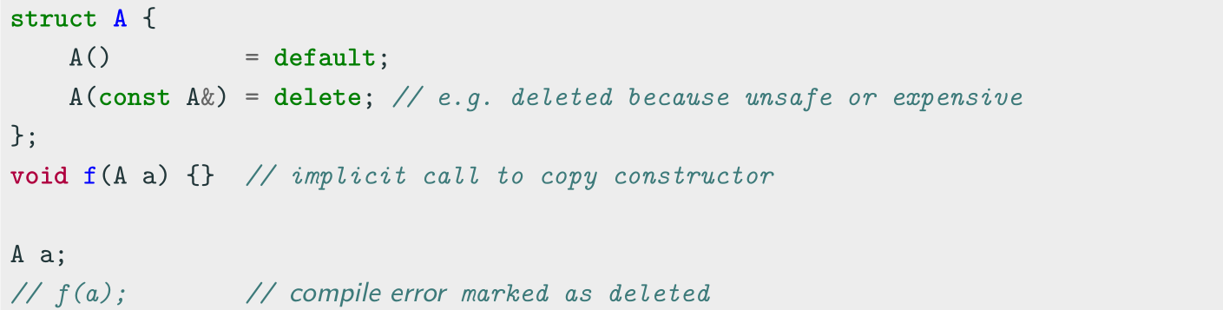
Class Keywords——delete
delete Keyword ( C++11 )
The delete keyword explicitly marks a member function as deleted and any use results in a compiler error. When it is applied to copy/move constructor or assignment, it prevents the compiler from implicitly generating these functions
The default copy/move functions for a class can produce unexpected results. The keyword delete prevents these errors

Slide 16
Polymorphism
virtual methods
Virtual Table
override keyword
final keyword
Common Errors
Pure Virtual Method
Abstract Class and Interface

Slide 17
Polymorphism
Polymorphism
In Object-Oriented Programming (OOP), polymorphism (meaning “having multipleforms”) is the capability of an object of mutating its behavior in accordance with the specific usage context
• At run-time, objects of a base class behaves as objects of a derived class
• A Base class may define and implement polymorphic methods, and derived classes can override them, which means they provide their own implementations, invoked at run-time depending on the context

Slide 18
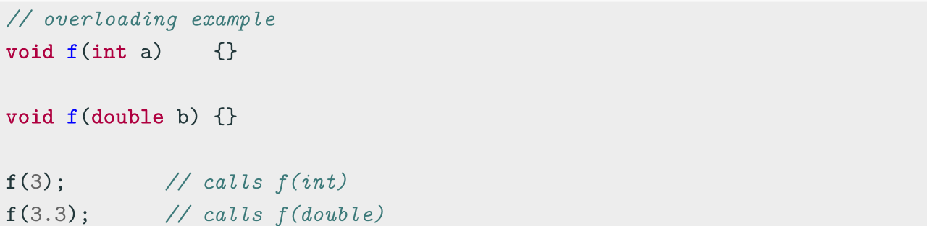
Polymorphism vs. Overloading
Overloading is a form of static polymorphism (compile-time polymorphism)
In C++, the term polymorphic is strongly associated with dynamic polymorphism
(overriding)

Slide 19
Function Binding
Connecting the function call to the function body is called Binding
• In Early Binding or Static Binding or Compile-time Binding, the compiler identifies
the type of object at compile-time
- the program can jump directly to the function address
• In Late Binding or Dynamic Binding or Run-time binding, the run-time identifies
the type of object at execution-time and then matches the function call with the
correct function definition
- the program has to read the address held in the pointer and then jump to that
address (less efficient since it involves an extra level of indirection)
C++ achieves late binding by declaring a virtual function

Slide 20
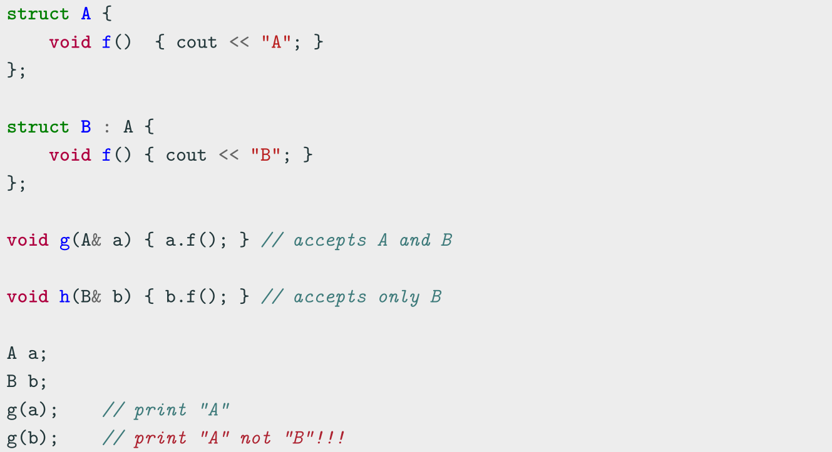
Polymorphism - The problem

Slide 21
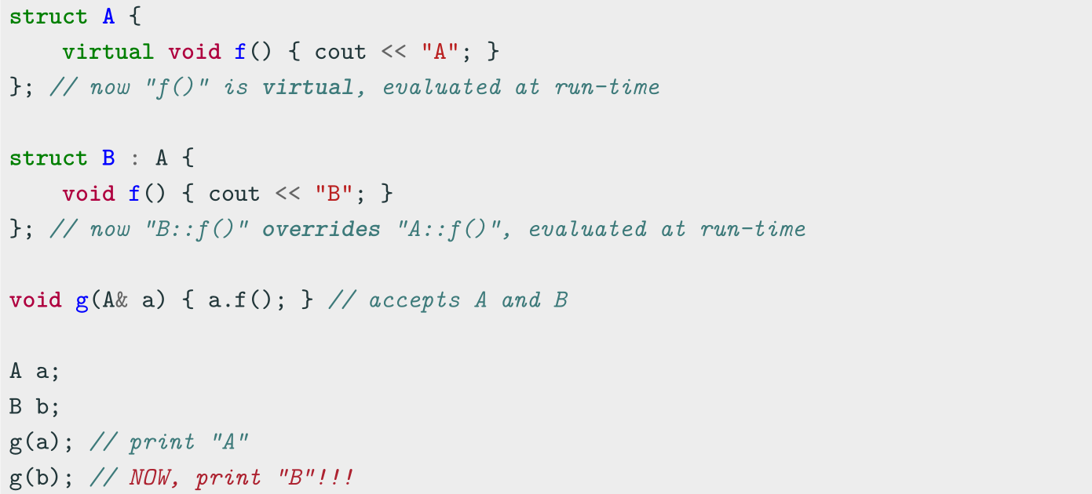
Polymorphism - virtual method
The virtual keyword is not necessary in derived classes, but it improves readability and
clearly advertises the fact to the user that the function is virtual

Slide 22
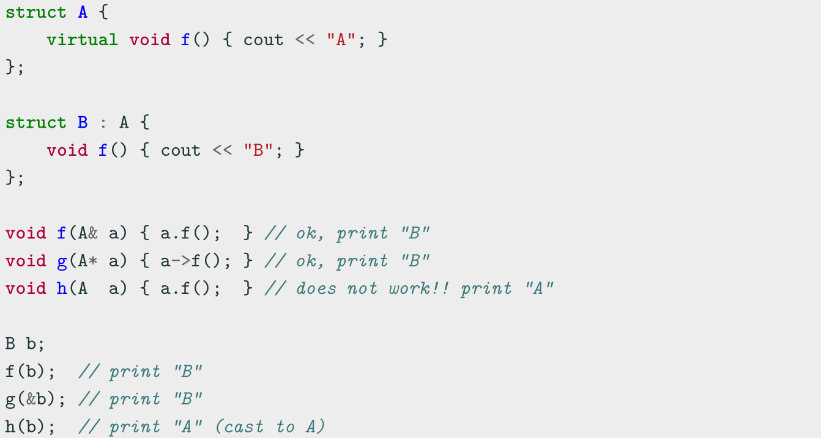
When virtual works

Slide 23
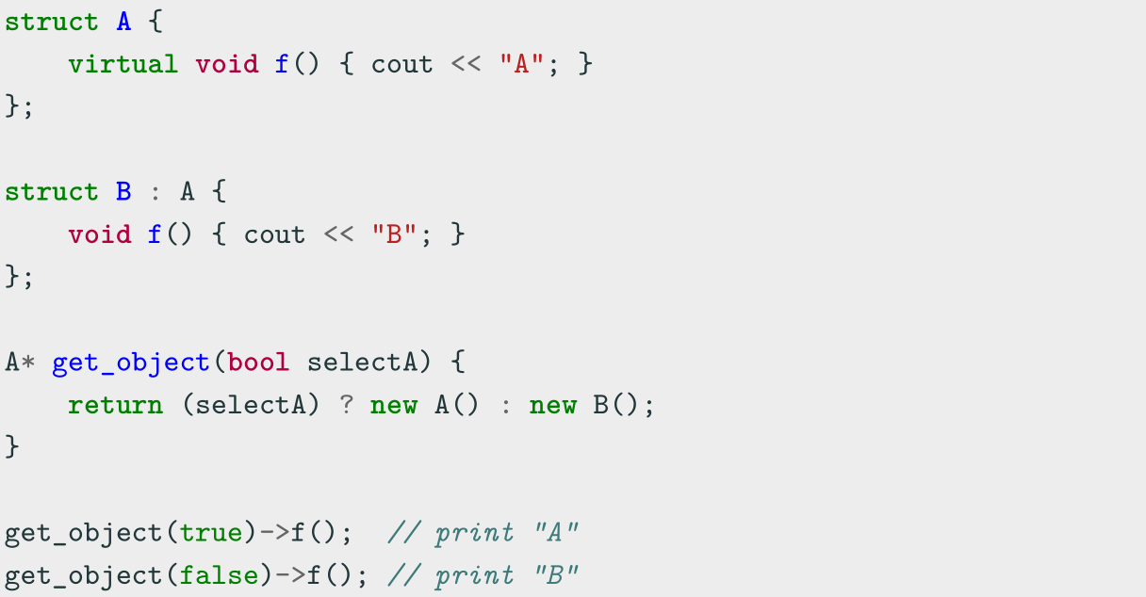
Polymorphism Dynamic Behavior

Slide 24
Virtual Table
vtable
The virtual table (vtable) is a lookup table of functions used to resolve function calls and support dynamic dispatch (late binding)
A virtual table contains one entry for each virtual function that can be called by
objects of the class. Each entry in this table is simply a function pointer that points to
the most-derived function accessible by that class
The compiler adds a hidden pointer to the base class which points to the virtual table
for that class (sizeof considers the vtable pointer)

Slide 25
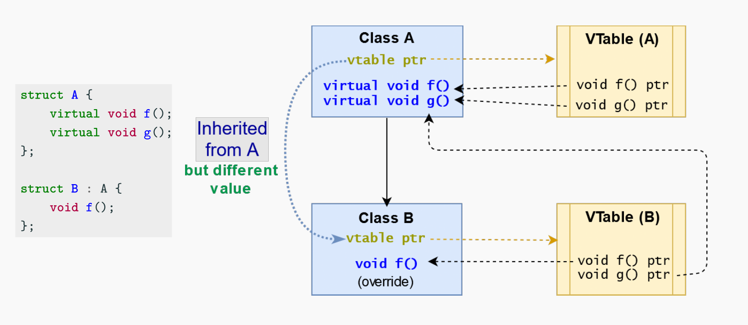
Virtual Table

Slide 26
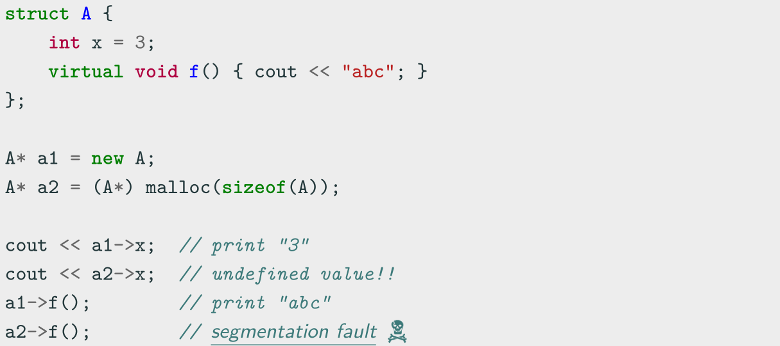
Does the vtable really exist? (answer: YES)
Lesson learned: Never use malloc in C++

Slide 27
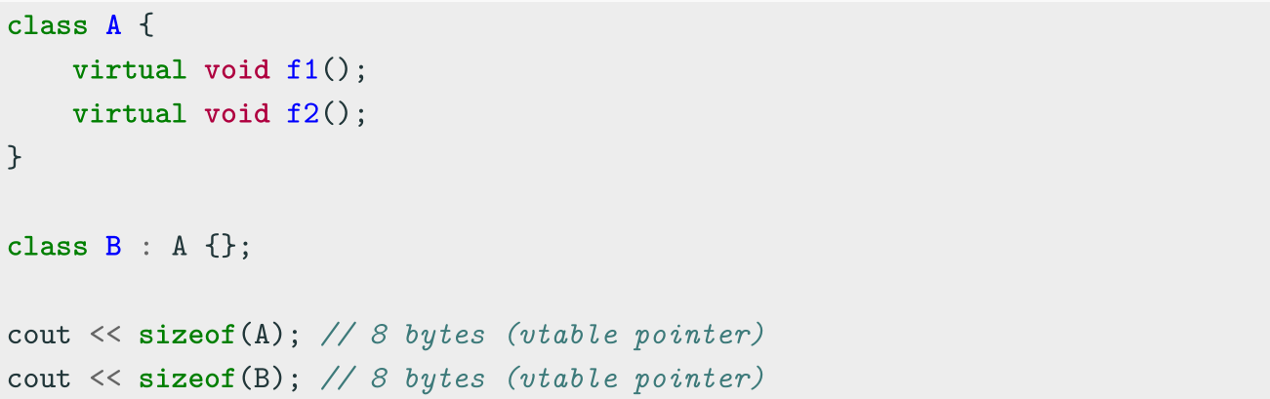
Virtual Method Notes
virtual classes allocate one extra pointer (hidden)

Slide 28
override Keyword
override Keyword ( C++11 )
The override keyword ensures that the function is virtual and is overriding a virtual function from a base class
It forces the compiler to check the base class to see if there is a virtual function
with this exact signature
override implies virtual ( virtual should be omitted)

Slide 29
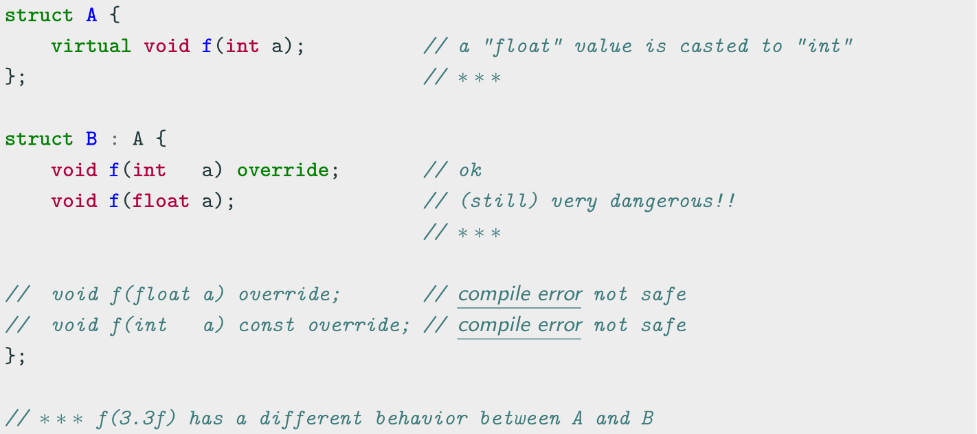
override Keyword

Slide 30
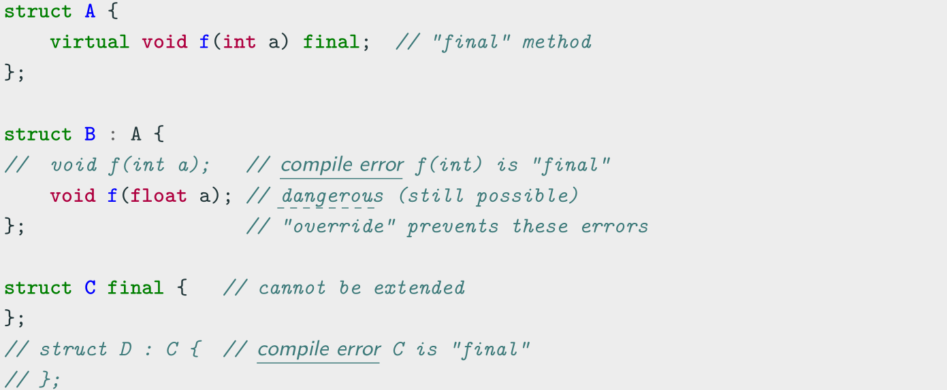
final Keyword
final Keyword ( C++11 )
The final keyword prevents inheriting from classes or overriding methods in derived classes

Slide 31
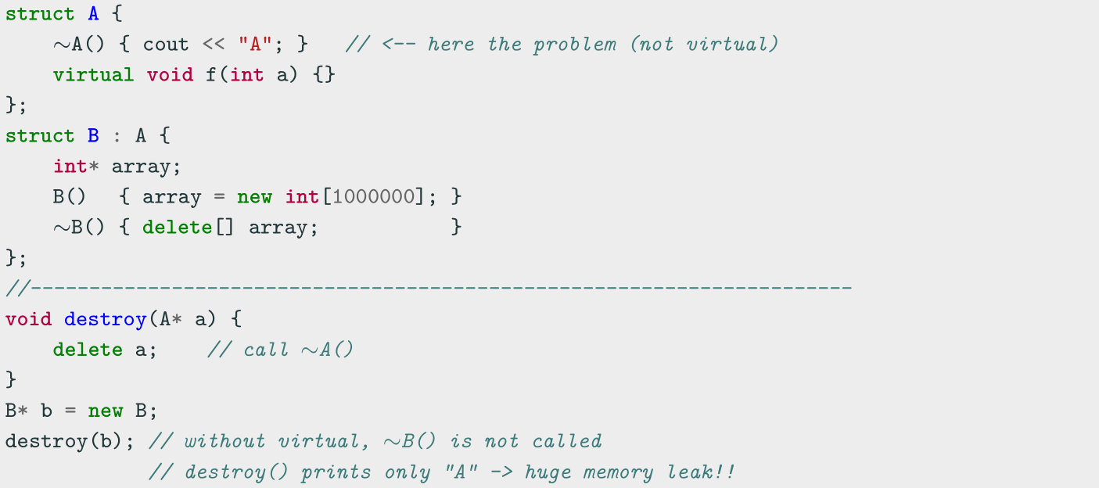
Virtual Methods (Common Error 1)
All classes with at least one virtual method should declare a virtual destructor

Slide 32
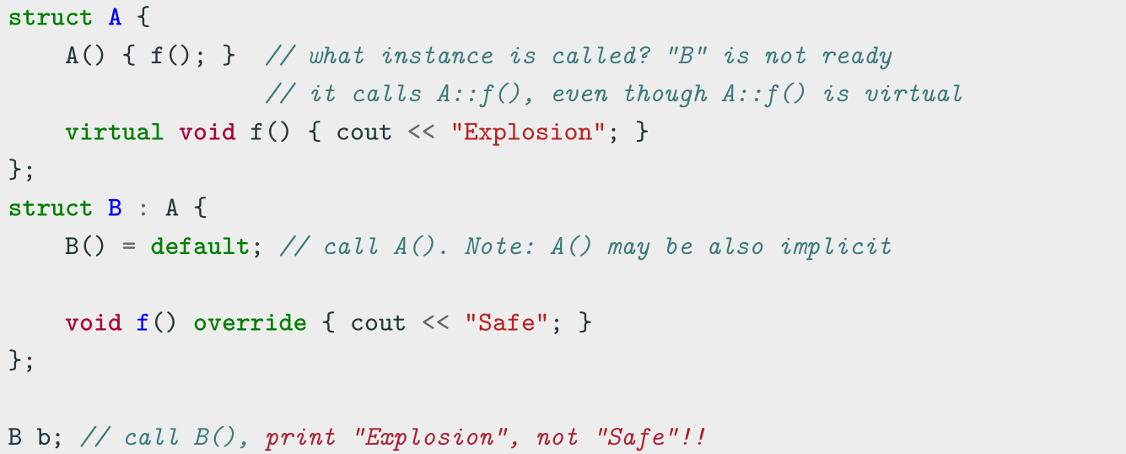
Virtual Methods (Common Error 2)
Do not call virtual methods in constructor and destructor
• Constructor: The derived class is not ready until constructor is completed
• Destructor: The derived class is already destroyed

Slide 33
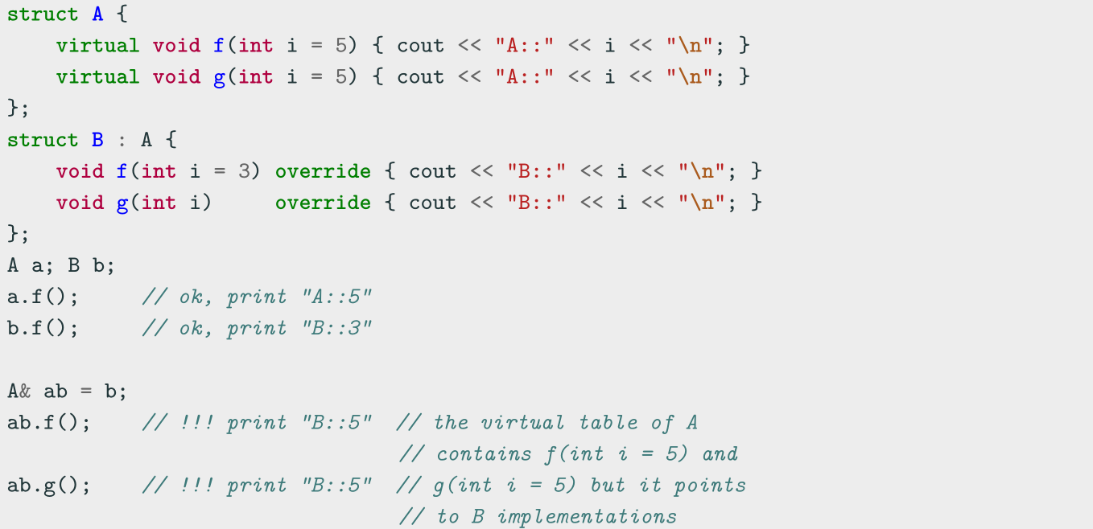
Virtual Methods (Common Error 3)
Do not use default parameters in virtual methods
Default parameters are not inherited

Slide 34
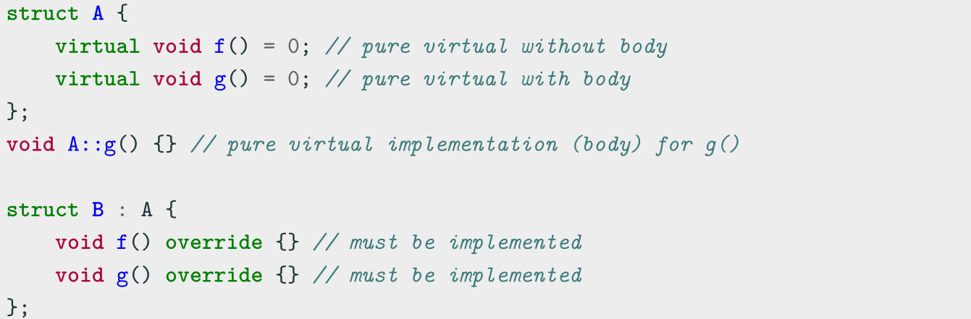
Pure Virtual Method
Pure Virtual Method
A pure virtual method is a function that must be implemented in derived classes (concrete implementation)
Pure virtual functions can have or not have a body

Slide 35
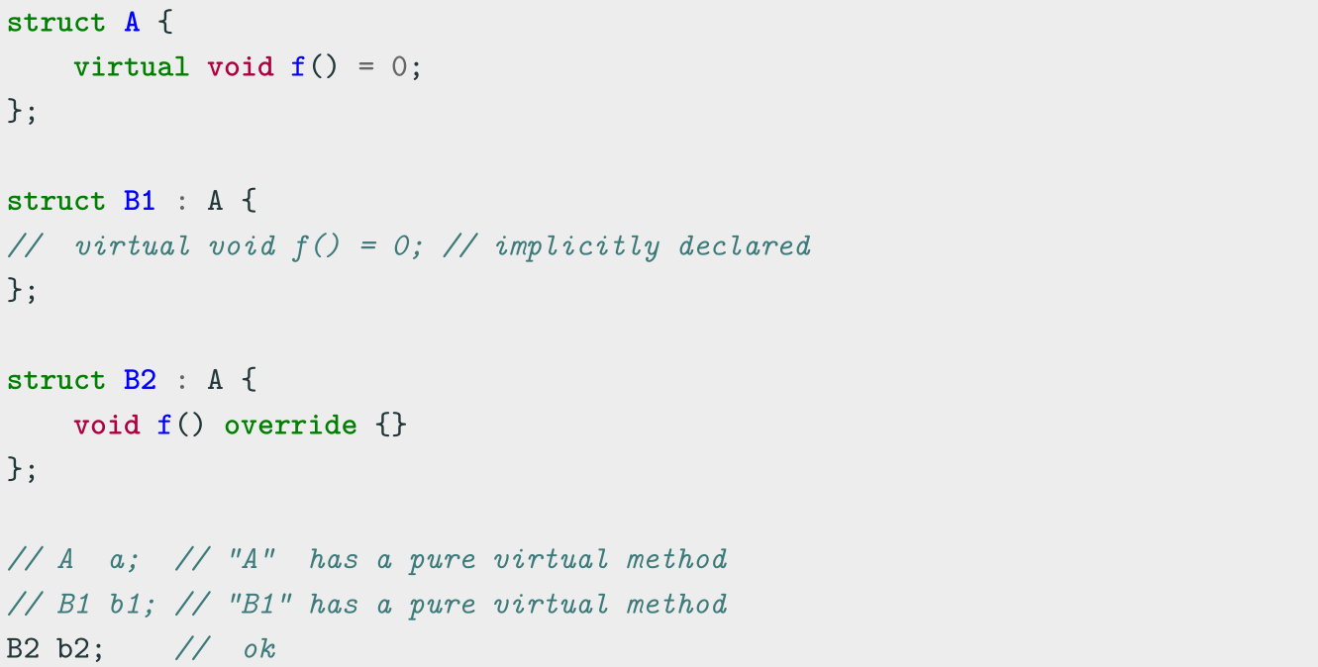
Pure Virtual Method
A class with one pure virtual function cannot be instantiated

Slide 36
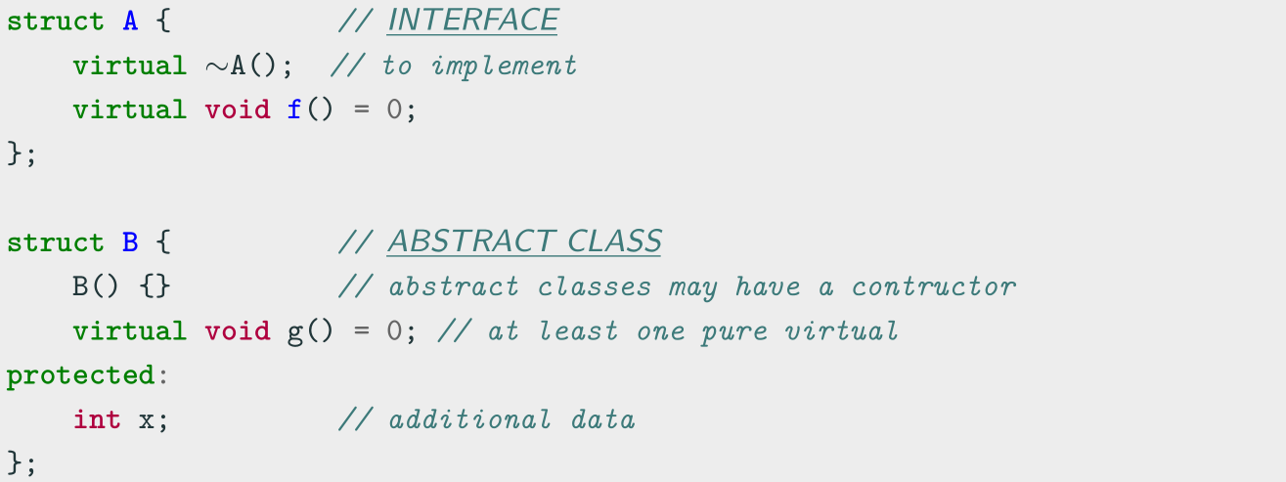
Abstract Class and Interface
• A class is interface if it has only pure virtual functions and optionally (suggested)
a virtual destructor. Interfaces do not have implementation or data
• A class is abstract if it has at least one pure virtual function

Slide 37
Coding for love, Coding for the world
Qijun Zhao
qjzhao@scu.edu.cn

